Slide 1
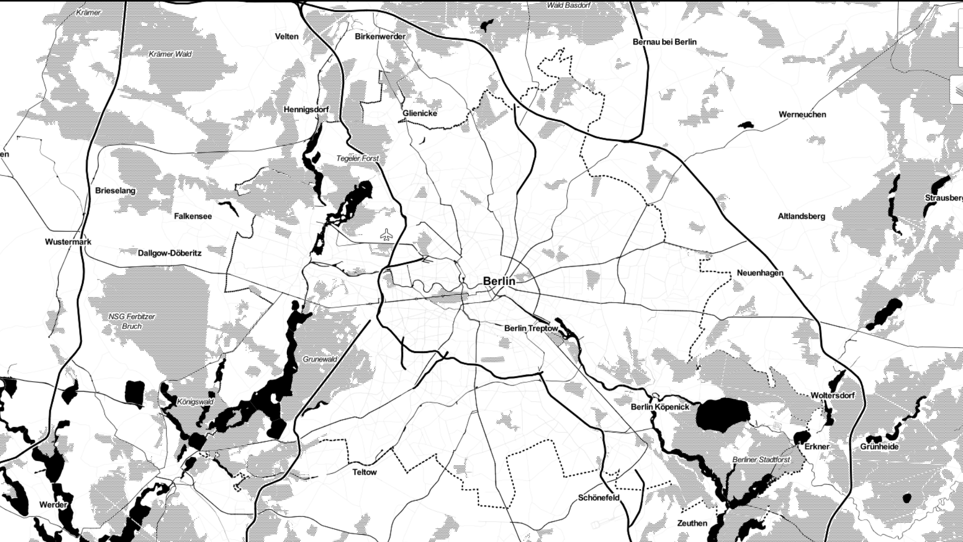
Berlin Traffic AccidentS
Interactive
Visualization
Exploring the Dangers of Berlin
Paul Kollhof
07.10.2022 – Berlin

Slide 2
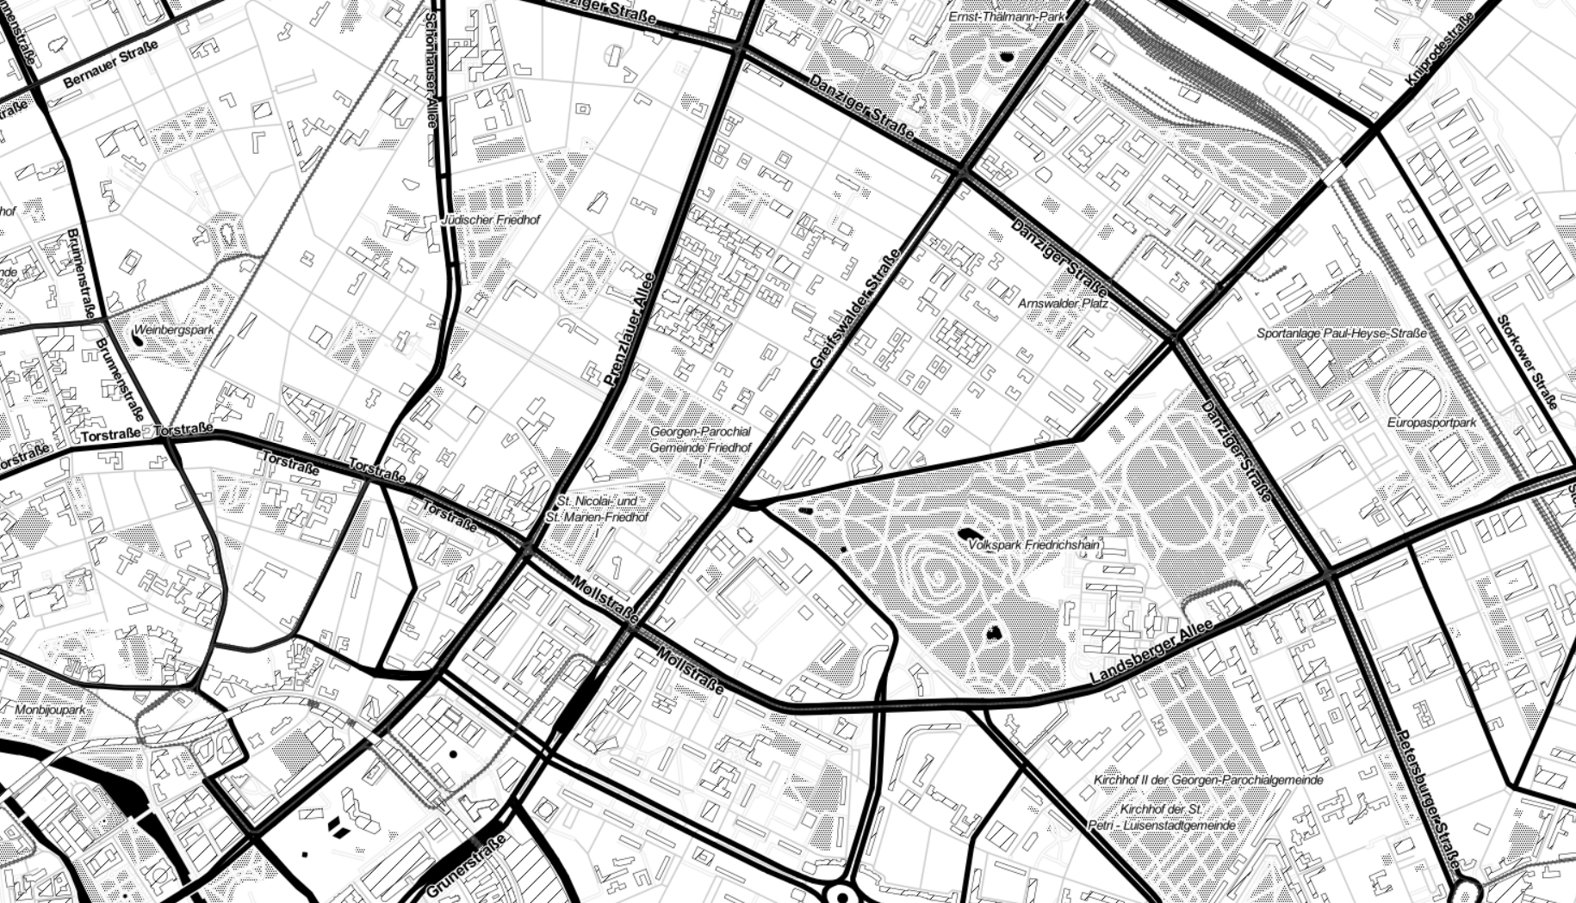

Data
OpenDataBerlin (www.daten.berlin.de)
Traffic accident data from 2018-2021
Registry of ~ 50.000 traffic accidents
Visualization
Geopandas, Folium
OpenSreetMap API

Slide 3
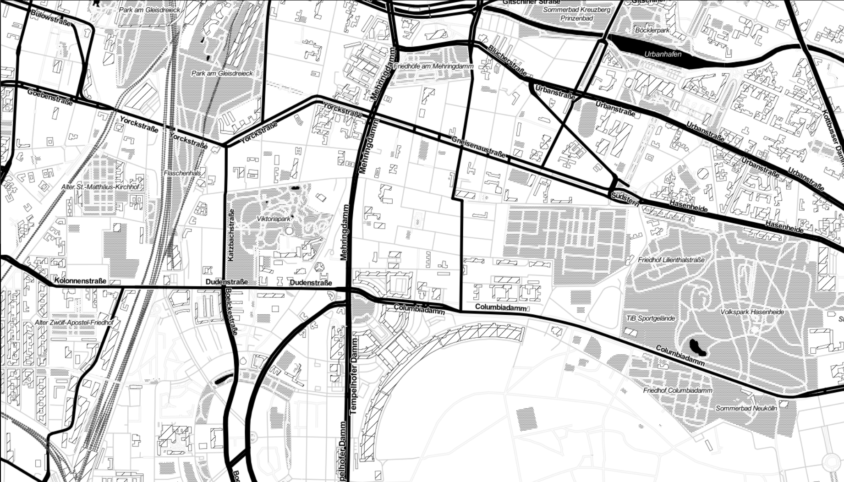

Who cares
Loves data, stats and numbers
Wants to explore Berlin by bike
Needs to know how dangerous it is

Slide 4
Who cares
Loves data, stats and numbers
Wants to explore Berlin by bike
Needs to know how dangerous it is

